Slide 1
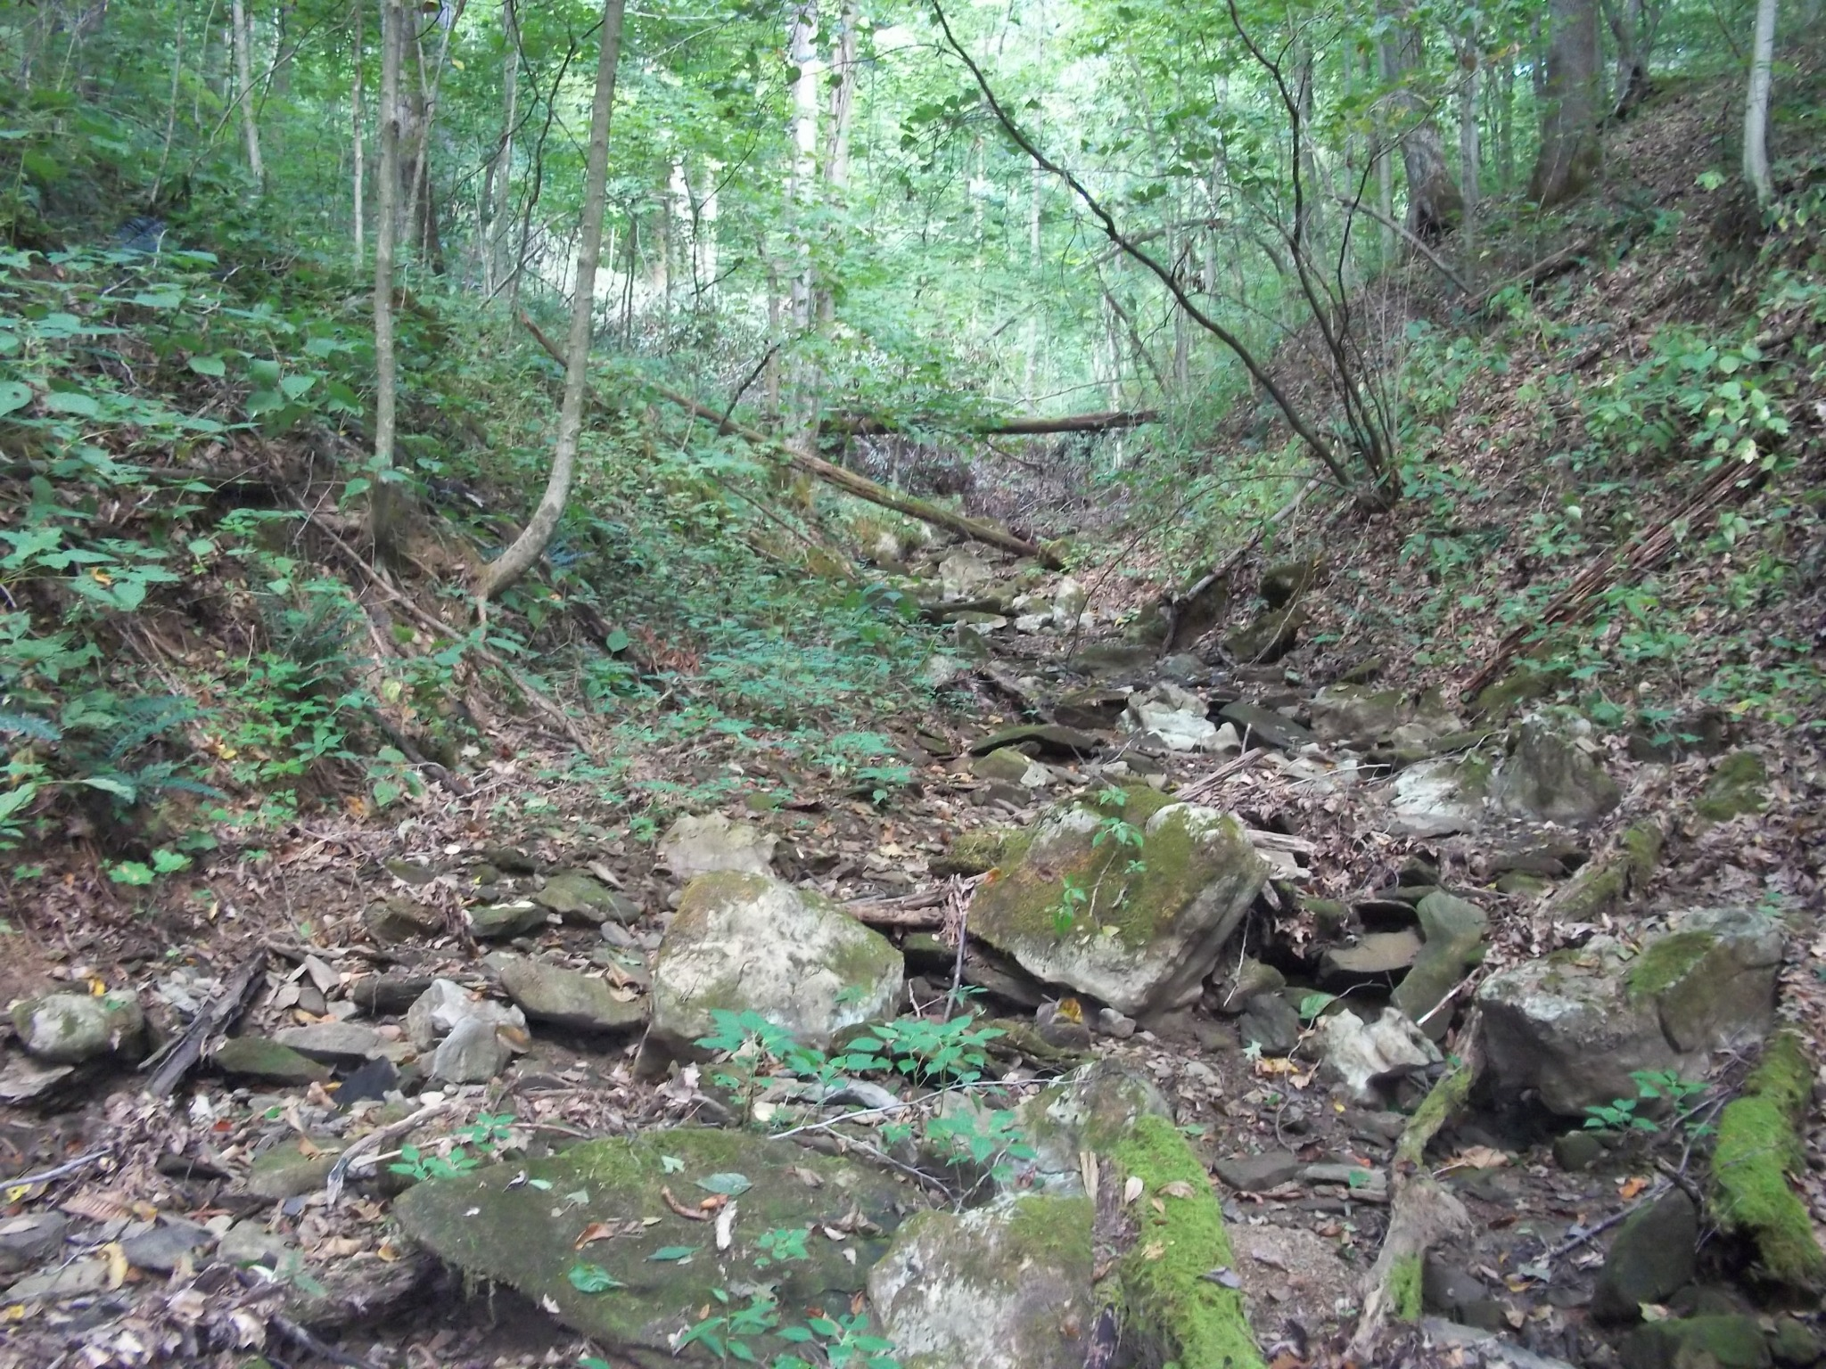
Stream Quality Investigation
A quick introduction for today’s activity!
Created By:
Appalachian Watershed Research Group
The Voinovich School of Leadership & Public Affairs
Ohio University
A special thanks to the AEP Foundation!

Slide 2
What would you expect to see in a healthy stream?
List 5 things you might expect to see in a healthy stream on your handout.

Slide 3
How do scientists determine stream quality?
Habitat Assessment
  What habitats are available for aquatic life?
Water Chemistry
  Are the parameters within the normal range that allows aquatic life?
Biological Indicators
  What algae, macroinvertebrates, and fish are present?
  Today you will be making observations in each category to determine which stream (A or B) has higher water quality, and is ultimately a healthier stream.

Slide 4
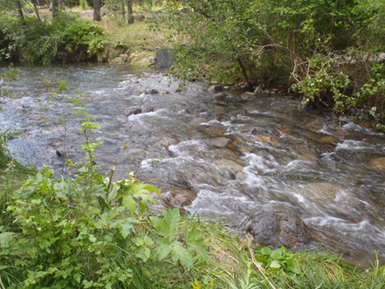
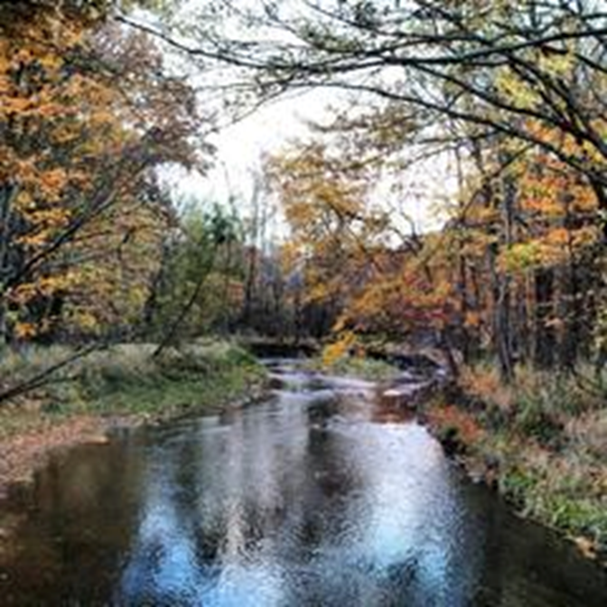
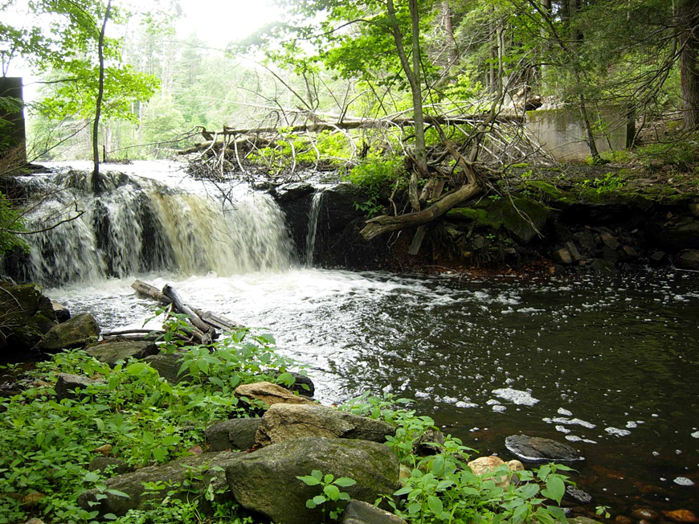
Habitat Keywords
Vocabulary | Definition | Photo
Riffle | Rocky or shallow part of a stream or river with rough water Riffles provide oxygenated water.
Run | The main body of a stream that runs smoothly downstream
Pool | Deep areas of slow moving water Pools provide deep water for fish.

Slide 5
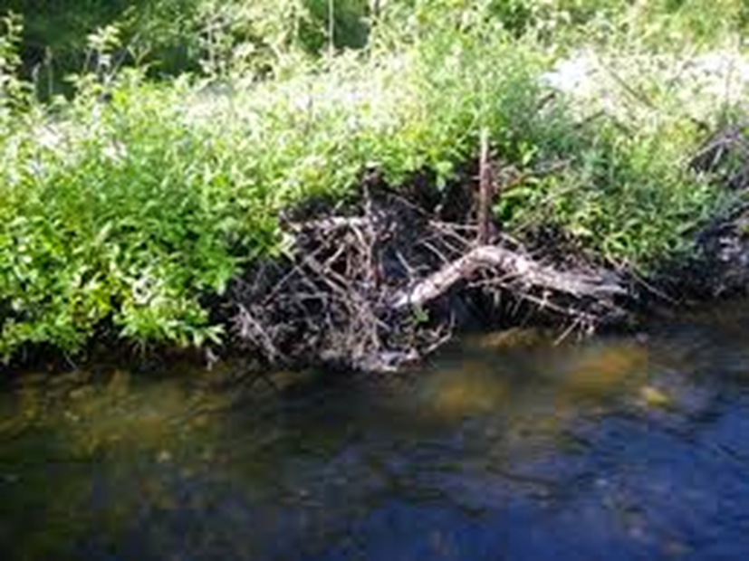
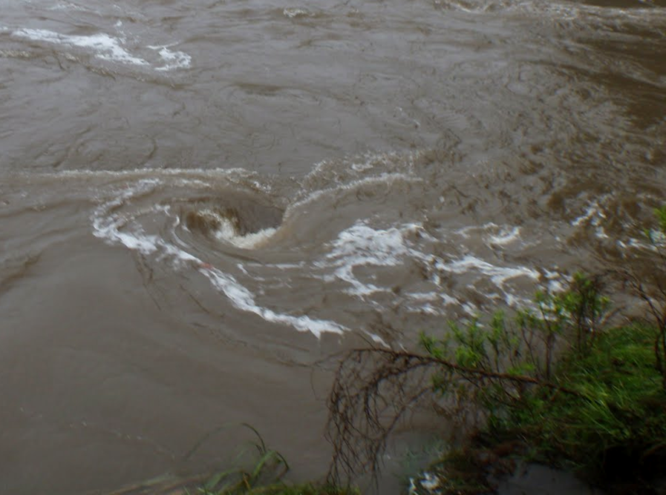
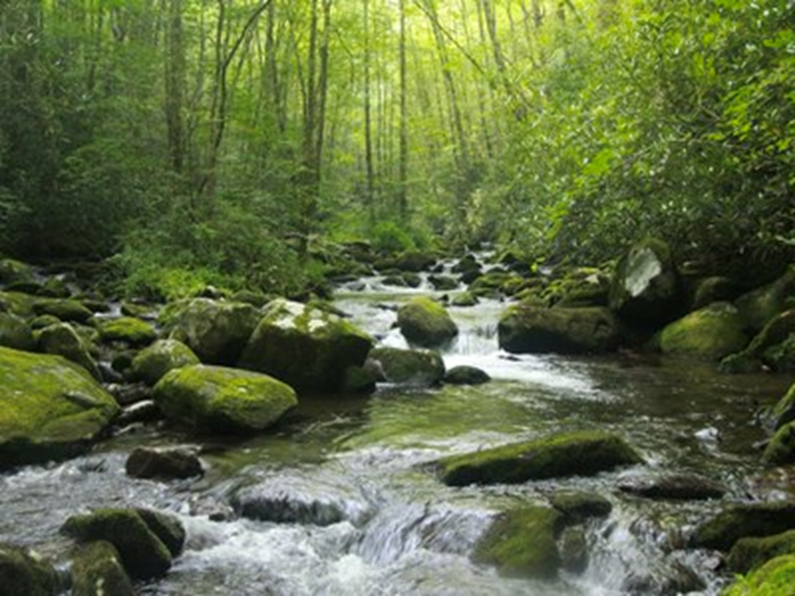
Habitat Keywords Continued
Vocabulary | Definition | Photo
Root Wad | Exposed roots of a fallen tree Root wads are good protection for fish and bugs.
Eddy | A circular current of water
Riparian Zone | Land that borders the river Trees are an important part of the riparian zone, they provide shade to keep water cool in summer.

Slide 6
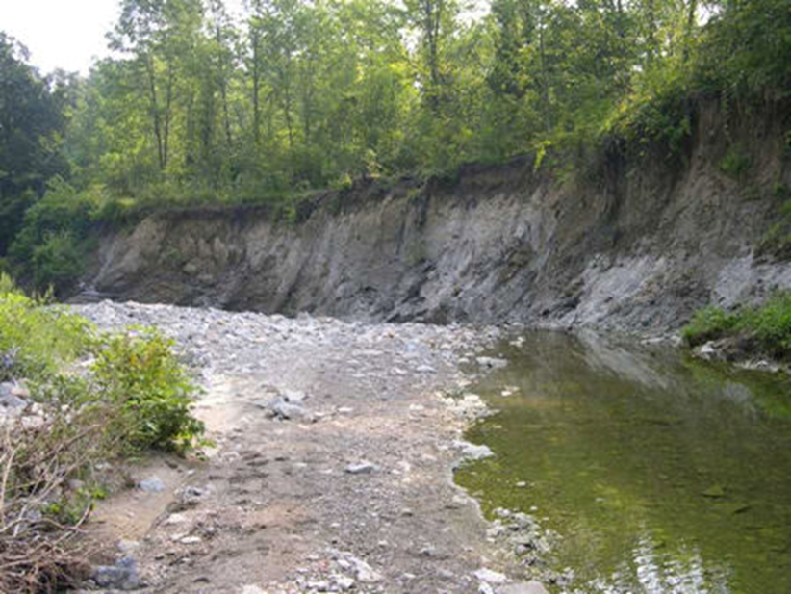
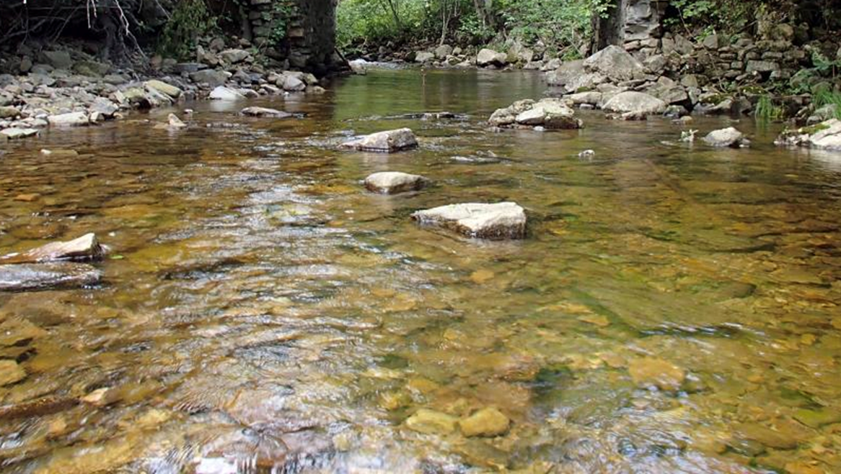
Habitat Keywords Continued…
Vocabulary | Definition | Photo
Undercut banks | Top of bank is further out into the creek than the bottom Undercut banks are an indicator of high flow.
Substrate | The sediment or material at the bottom of the stream Macroinvertebrates commonly live under large substrate in the stream, too small of substrate such as dirt can clog their gills.

Slide 7
Water Chemistry
Parameter | Normal Range | Actual Measurement
pH | 6.5- 8.0 | 7.2
Dissolved Oxygen | 6.0- 9.0 | 3.2
Total Dissolved Solids | Below 1000 mg/ L | 650 mg/ L
Conductivity | 400- 600 umhos/cm | 500 umhos/cm

Slide 8
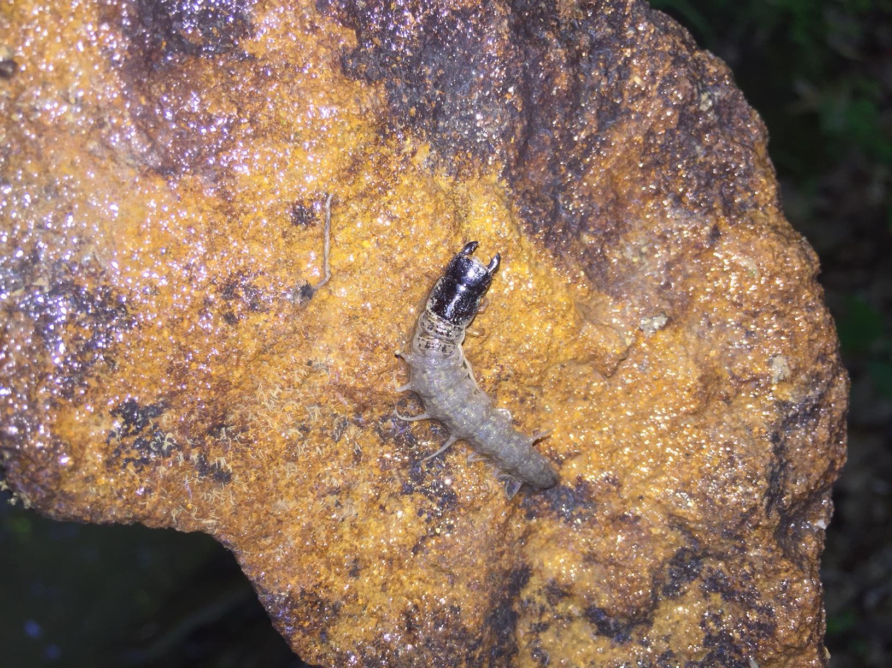
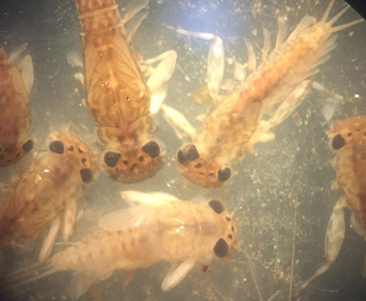
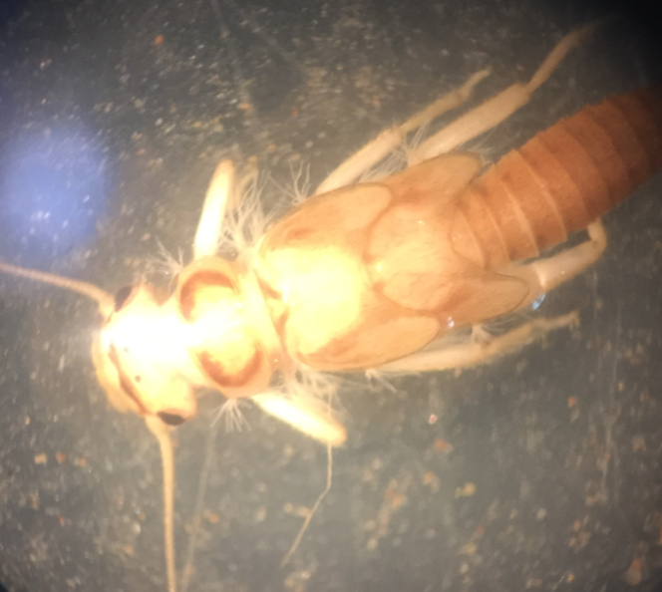
Biological Indicators
Some organisms are pollution sensitive, meaning their presence indicates that there is little pollution.
Use you macroinvertebrate identification sheets, and pollution tolerance sheet to determine what the biology says about stream A or B.

Slide 9
Today’s Activity
Today you (students) will be at 3 different stations for 10 minutes each.
  Virtual Reality/ Habitat Assessment
  Macroinvertebrate Identification
  Water Chemistry
At each station be sure to record information that would be helpful in determining which stream is higher quality.
Be sure to remember what parameters and features are important to record at each station!

Slide 10

Which stream is higher quality based on observations?

Slide 11


Special Thanks To:
Appalachian Watershed Research Group
The Voinovich School of Leadership & Public Affairs
Ohio University
AEP Foundation

